Slide 1
Detection of Astronauts’ Speech and Language
Disorder Signs during Space Missions using Natural Language Processing Techniques
Raluca Stefania Trofin¹, Costin Chiru¹, Cristian Vizitiu², Adrian Dinculescu^{2,4}, Ruxandra Vizitiu³,
Alexandru Nistorescu^{2,5}
Majwega Jackson_20266030
CSE712
Uploaded link: https://drive.google.com/file/d/1lhFvJBDbLc27p8gckzscuh0alHI_mh3O/view?usp=sharing

Slide 2
Introduction
As technology evolves at an alert pace, the desire and need for exploration of the outer space becomes more and more prevalent. Human exploration and colonization of the Moon or Mars represents a strategic goal of international space agencies for the coming years.
Following the history of space travel, one can notice the indisputable necessity of human presence in missions. Even though, over time, the automation of the exploration process through artificial satellites has been tried, it has often been proven that human intervention is much more effective due to the astronauts’ ability to reason and act in unforeseen situations.
During space missions, astronauts are exposed to a myriad of stressors such as: microgravity, lack of atmospheric pressure, extreme temperatures, mechanical shocks, solar and cosmic radiation, isolation, confinement, multicultural issues, limited habitability etc. Hence, the human body undergoes through complex adaptations both physiologically and psychologically

Slide 3
PROBLEM FORMULATION
Besides the biomedical problems, long duration spaceflight (more than 6 months), the psychosocial impairments namely interpersonal and intrapersonal psychological effects, are critical, as depression, lack of motivation and concentration, irascibility, asthenia, anxiety, emotional instability, interpersonal tension etc
In this paper, we present a real-time, non-invasive, noncontact and non-obtrusive method for determining indices through which to detect speech and language disorder signs (SLDS) of astronauts, as reflection of their psychological behavior.

Slide 4
KEY PLAYERS
Astronauts
NASA
Ground staff

Slide 5
SIGNS OF SPEECH AND LANGUAGE DISORDERS
There have been numerous tests on humans in ground-based analogue environments serving as astronauts training and/or physiological/behavioral health research platforms (e.g. Concordia station situated on Antarctic mainland etc.). However, there is no decisive indicator of psychological degradation which, detected in time, could act as psychological countermeasure.
In 2015, Vizitiu and Vizitiu pointed out the potential of SLDS in astronauts associated with human space adaptability which are valid indicators of the psychological disorders experienced by astronauts.
Main potential categories of speech and language disorders relevant for the space context
rhythm and fluency disorders
speech sound disorders
oral language disorders
voice disorders.

Slide 6
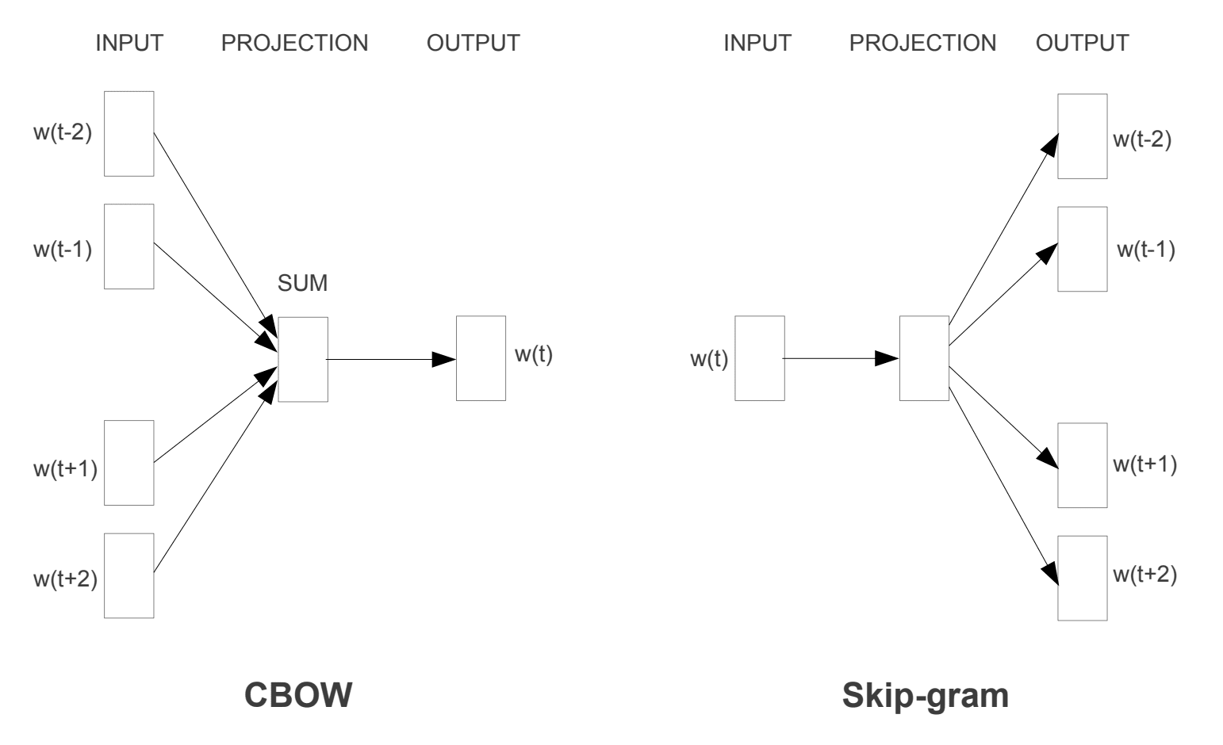
Natural language Processing
Embedding
Attempts to encompass the meaning of a word from a morphological, contextual and statistical point of view, related to the whole corpus and the relationships between the documents and the terms that compose them
The first variant tries to predict a word based on a context, the second variant tries to predict a word based on several contexts and the last one tries to predict more contexts based on one word

Slide 7
SLDS DETECTION - NLP APPLIED ON NASA MISSIONS – PROPOSED SYSTEM
This paper is focused on analyzing the problem of SLDS progression of astronauts during short duration spaceflight missions from two perspectives within the realm of oral language: the structuring of their used internal language and the feelings experienced by the astronauts manifested in it.
In order to capture oral language disorders, it has been used two approaches based on coherence and cohesion, while for detecting the astronauts’ feelings, a third approach based on the sentiment valence of the used words.

Slide 8
Model representation
The first approach assumes that a coherent and cohesive discourse involves the use of words that are appropriate to the context of a sentence. This translates in the use of the same sentence of terms that are semantically close. Thus, it was set out to identify a coherence metric whose evolution could be subsequently analyzed for each astronaut during the mission
A similar approach analyzes the evolution of an astronaut’s concerns over time. Thus, the similarity of the current sentence with the previous sentence spoken by the astronaut is calculated. In this way, the evolution of the contexts approached by the individual astronaut in his speech is traced through a cumulative counter.
The third approach proposes the analysis of the emotional dynamics of astronauts: their feelings expressed in the conversations. There are 16 categories of feelings, 8 being positive and the other 8 being negative. Thus, the sentence of an astronaut is confronted with the 16 feelings. Specifically, the objective was to find out to what extent a sentence expresses each of these feelings and how this proportion changes over time.

Slide 9
Data Sets
The data used for analysis consisted of 8 of the public transcripts of the NASA missions, available online:
Apollo 8,
Apollo 11,
Apollo 13,
Gemini III,
Mercury III,
Mercury IV,
Mercury VI,
Mercury VII.
Most of those transcripts contained only the Technical Air-to-Ground Voice Transmission and thus contained 2 parties: mission-ops and astronauts

Slide 10
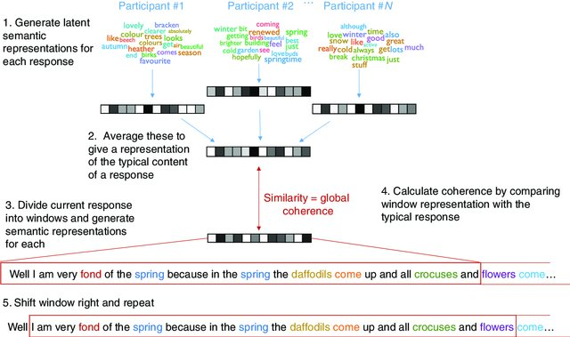
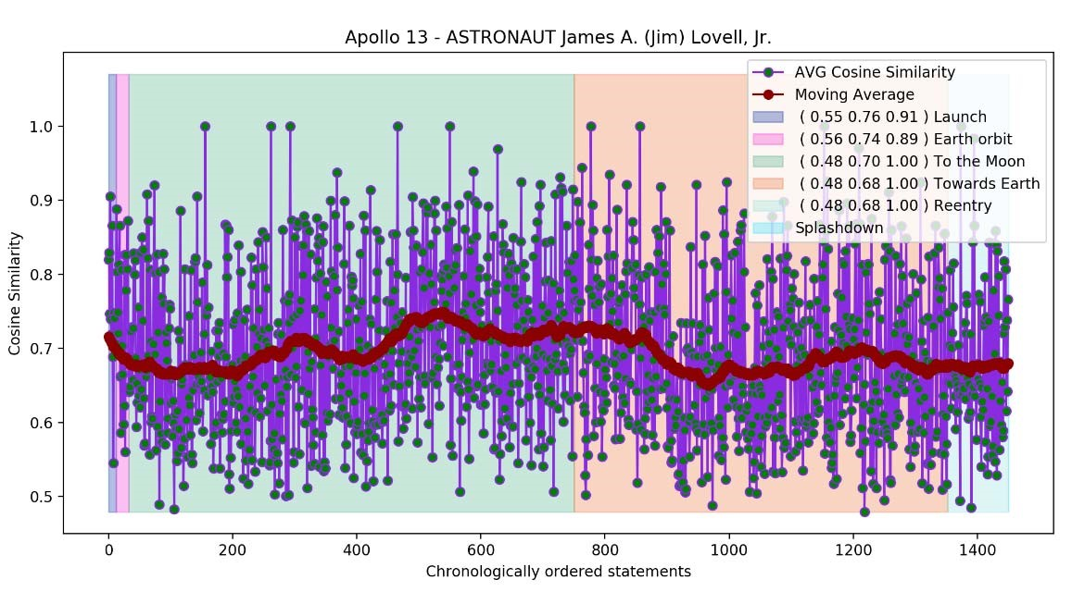
Speech coherence approach
The graph shows the time segmentation of the mission according to its important stages because it was considered that the
SLDS in terms of oral language disorders are closely correlated with the stages of the mission.
Each identified interval, it was calculated the minimum, the average and the maximum similarities obtained for the sentences in that time frame for identifying a hidden trend

Slide 11
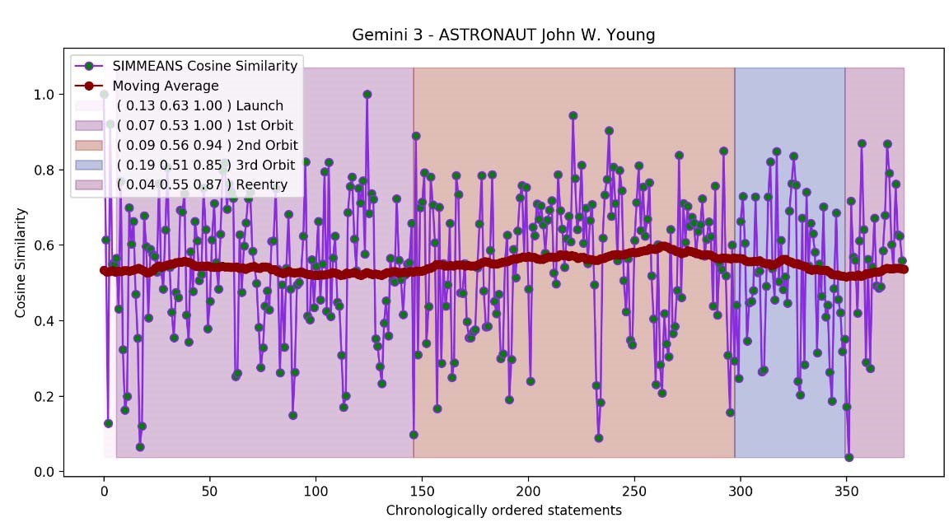
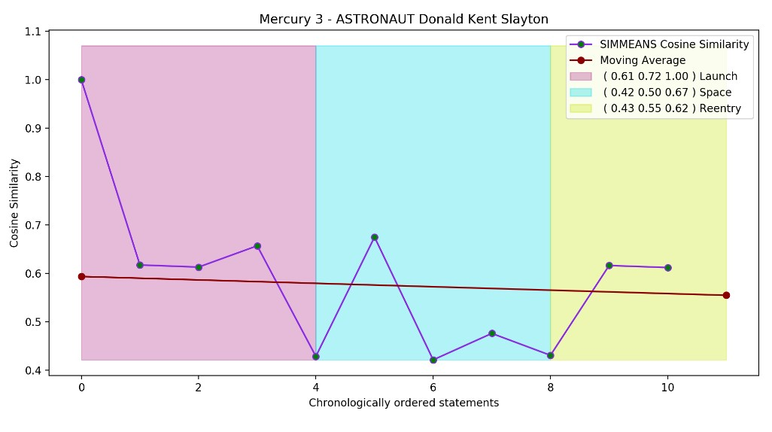
intervals.
The second approach uses the average vectors per sentence calculated as described above and calculates the similarity between the average vector of the current phrase and the average vector of the previous one.
In this way, the evolution of the astronauts' concerns is traced over time. Thus, the more the astronaut's concerns vary, the more likely his or her psychological activity is suggesting SLDS.
Fig.
2
.
Evolution
of
the astronaut's
c
oncerns
based on
the similarity

Slide 12
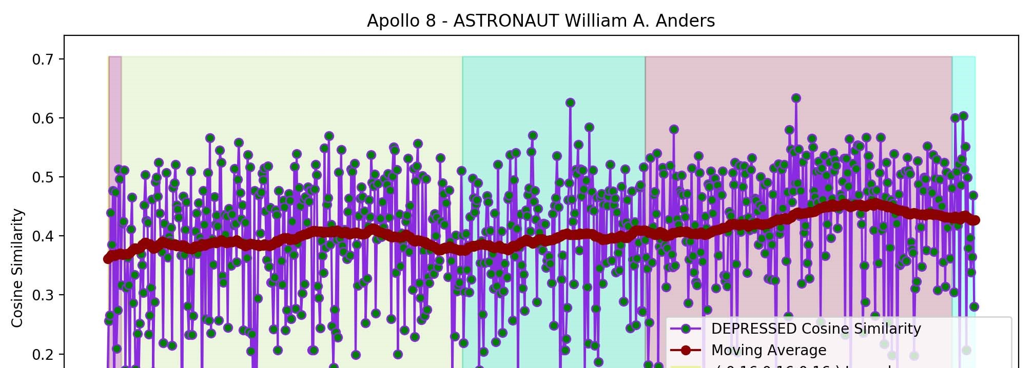
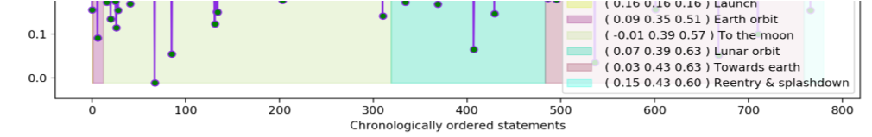
Sentiment analysis approach
The third approach is to determine the predominant feelings and the evolution of these feelings in the individuals' psychological behaviour during the short duration human spaceflight missions.
Feelings considered:
Pleasant
Unpleasant
Fig.
3
.
The evolution
of
th
e similarity
b
etween
th
e astronaut's
s
entences

Slide 13
Contributions
It was designed to monitor the astronauts' emotional states and detect the tendency to increasingly manifest negative feelings. Beyond these aspects, an important element in the results validation is the distinction between the parties involved in the analyzed transcripts: the staff on-ground and the astronauts

Slide 14
Limitations
The evolution graphs of the manifested feelings did not reveal a tendency towards increasing the negative feelings or decreasing the positive feelings, over time. Still, their aggregation based on key mission intervals revealed the expected results for some of the astronauts. The lack of categoric results does not lie exclusively in the used NLP approaches.
These may occur as a result of insufficient data currently available, but also as a result of the short, formalized used phrases, that are specific to ground-space communications.
Also, it must be taken into account that the analyzed data reside to very short-duration human spaceflight missions (a few days), where the psychological states of astronauts would have not significantly altered or astronauts would have succeeded in maintaining their normal psychological behavior

Slide 15
Future suggestions
The results open up new research and development perspectives especially towards human spaceflight missions, but not merely.
In order to improve and refine the herein metrics, the next scientific steps shall target data, to be analyzed, residing to at least 2-month short duration space mission and/or, if available, to long duration human spaceflight missions (more than 6 months).
The perspective of such data provides enough information to analyze with focus on the used algorithms and methods of interpretation.

Slide 16
Conclusion
The above research is valid for it states an opportunity for future researchers and it has a strong contribution to Aeronautics sector

Slide 17


